Slide 1
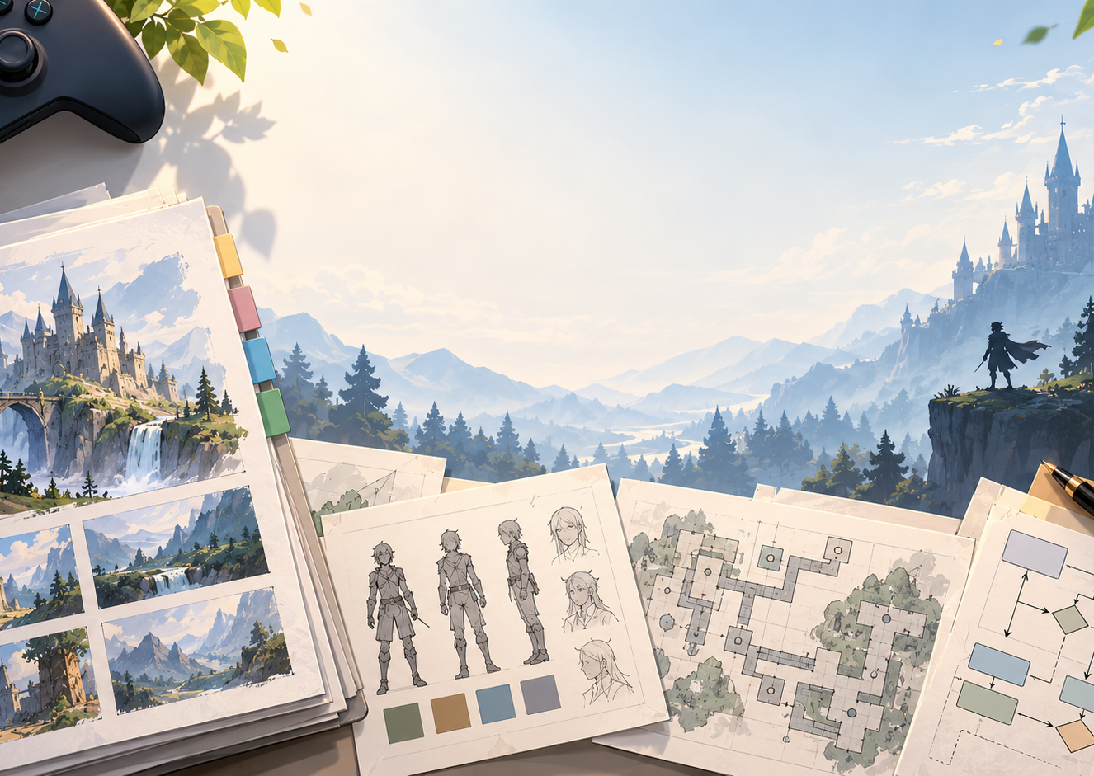

CO1035: Game Concepts
Lecture 2A:
Game Design Documentation

Slide 2
Objectives
List the different types of documentation in Games Development
Understand their content and their uses.
Structure and create a game design document.

Slide 3
Introduction
During the course of a game development life-cycle, several documents are developed.
These documents serve different purposes:
  Pitch and secure funding or publisher approval
  Define and describe the game for internal development
  Support project planning and team coordination
  Communicate technical requirements and production goals
  Ensure artistic and narrative consistency
  Provide reference material for quality assurance and updates
  Promote the game to consumers and media

Slide 4
Types of Documents
High Concept
Concept Document
Pitch Document
Game Design Document (GDD)

Slide 5
High Concept Document
A high-concept document is a short, concise summary that presents the core idea of the game, and it is created during the concept phase.
It captures the game’s essence in a way that is clear, engaging and easy to understand.
Purpose:
  To pitch the game’s vision to publishers, investors, or a development team.
  To spark interest and communicate what makes the game unique.
  To serve as the first written step toward developing the full game design.
Typical Contents:
  Game Title and Genre
  One-sentence “elevator pitch”
  Core gameplay idea or hook of the game
  Target Audience and platform
  Key unique features

Slide 6
Concept Document
A concept document expands on the initial high concept document by outlining how the game will play, look and feel.
It transforms a raw idea into a structured proposal, ready for discussion and early planning.
Its size differs based on the nature of the game:
  Indie game: 2-4 pages
  Medium project: 5-10 pages
  Large project: 10-15 pages
Typically, it is developed during the late concept phase or early pre-production phases.

Slide 7
Concept Document (cont.)
Purpose:
  To develop the core gameplay mechanics and player experience
  To evaluate feasibility before major production begins
  To align creativity and technical teams around a shared vision
Typical Contents:
  Game overview and settings
  Core gameplay loop and progression
  Key features and mechanics
  Target audience and competitors
  Art direction and tone
  Business or monetization model

Slide 8
Pitch Document
A Pitch Document is a short presentation designed to sell the game idea to potential investors, publishers or studio executives.
It highlights the most exciting and marketable aspects of the game.
Typically, it is developed in parallel with the Concept document (late concept or early pre-production phases)
Purpose:
  Secure funding, approval or publishing deals
  To quickly communicate the game’s appeal and business potential
  To showcase visual materials that bring the concept to life.
Typical Content:
  Game Title, genre, target audience, platforms and elevator pitch
  Key gameplay features, innovations and Fundamental Art of the game
  Market potential and selling points
  Development timeline and budget summary

Slide 9
Game Design Document
GDD is the central blueprint of a video game, created during the pre-production phase.
This document is indented for the game development team ONLY.
Serves as the document from which the game is to be build.
Key points:
  It is the most current representation of everything there is to know about the game throughout development.
  A GDD can be thought of as the “game on paper”.
  Every element of the game is described in detail: narrative, characters, goals, mechanics, etc.
  Its structure can vary between organizations, but all GDDs share the same objective: telling developers what to develop

Slide 10
Game Design Document
Role in Game Development:
  Provides clarity and guidance to all departments: designers, programmers, artists, and writers
  Acts as a central communication tool, ensuring the entire team shares the same vision
  Serves as a living document that is constantly updated, though additions should eventually stop to maintain development focus
Scope and Size:
  Can be a single document or multiple documents, each covering specific elements or levels
  Can contain hundreds or even over 1000 pages of detailed information
  Breaks down every aspect of the game, including implementation plans, to guide production

Slide 11
Game Design Document Structure
Title Page
Game Overview
  Background
  Game play description
The Game World
  Levels / Key Locations
  Progression / Travel
Characters
  Player character(s)
  Non-player characters (NPCs)
  Character attributes
  Character abilities & development
Objects
  Interactive world elements (e.g. doors)
  Key Items (e.g. weapons)
  Pick-ups / Inventory Items
User Interface (UI)
  On screen display (OSD)
  Controller usage
  Camera / Point of View
Play Modes
Appendices (Detailed lists, tables etc.)

Slide 12
Game Design Document Structure
Title Page
Game Overview
  Background
  Game play description
The Game World
  Levels / Key Locations
  Progression / Travel
Characters
  Player character(s)
  Non-player characters (NPCs)
  Character attributes
  Character abilities & development
Objects
  Interactive world elements (e.g. doors)
  Key Items (e.g. weapons)
  Pick-ups / Inventory Items
User Interface (UI)
  On screen display (OSD)
  Controller usage
  Camera / Point of View
Play Modes
Appendices (Detailed lists, tables etc.)

Slide 13
Game Overview
The game overview gives the background story and describes the basic game play.
You should make a clear distinction in the Game Overview between the Background (story, setting, character) and Gameplay (i.e. a description of the game mechanics).
It should not contain too much detail; refer to other sections in the document where appropriate
  For example, when introducing a character in the overview, refer to the character
section for a full description
  Don’t include complex rules or tables etc. Such detail belongs later in the document.

Slide 14
Game Overview FAQs
What is the game?
Where and when does the game take place?
Who or what do I control as a character?
How many characters do I control?
What is my character’s objective?
How will my character achieve the objective?
What threats does my character face?
What competition does my character face?
What help can my character find?
What game is the nearest comparison?
How is it different?

Slide 15
Game Design Document Structure
Title Page
Game Overview
  Background
  Game play description
The Game World
  Levels / Key Locations
  Progression / Travel
Characters
  Player character(s)
  Non-player characters (NPCs)
  Character attributes
  Character abilities & development
Objects
  Interactive world elements (e.g. doors)
  Key Items (e.g. weapons)
  Pick-ups / Inventory Items
User Interface (UI)
  On screen display (OSD)
  Controller usage
  Camera / Point of View
Play Modes
Appendices (Detailed lists, tables etc.)

Slide 16
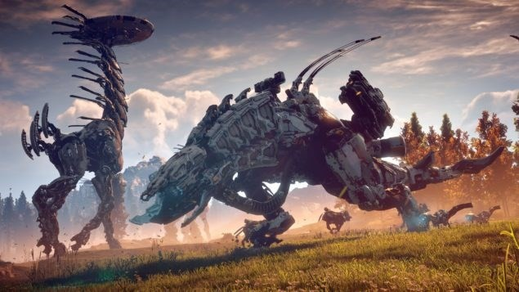
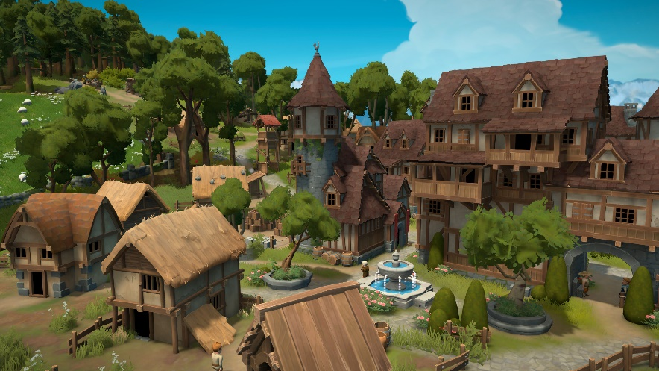
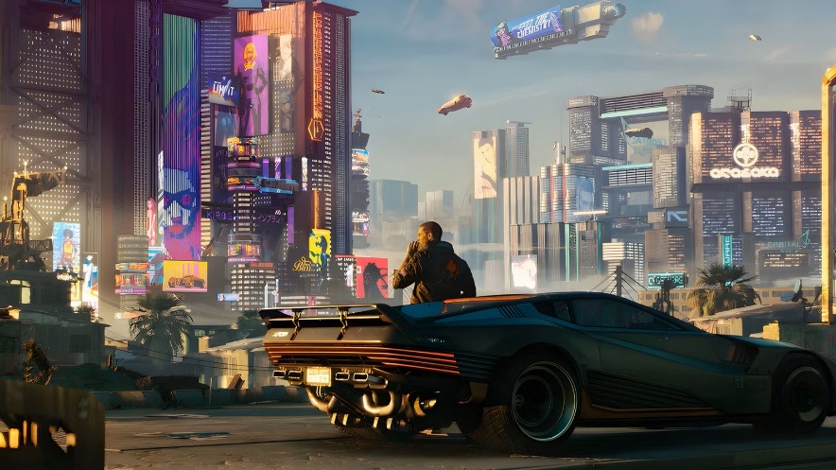
The Game World
This can be one of the larger sections of the design document.
Demonstrates every detail about the Game World and its design.
It should begin with an introduction
For example:
  In a post-apocalyptic world ruled by robotic creatures…
  In a medieval castle ruled by King Solomon and his army…
  In a futuristic world somewhere in 2150…

Slide 17
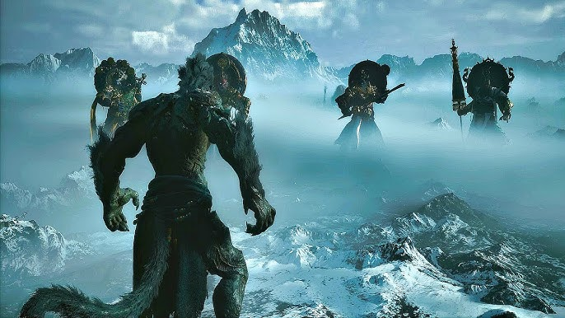
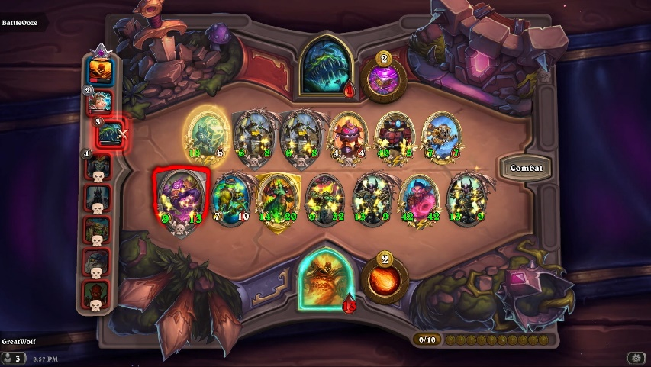
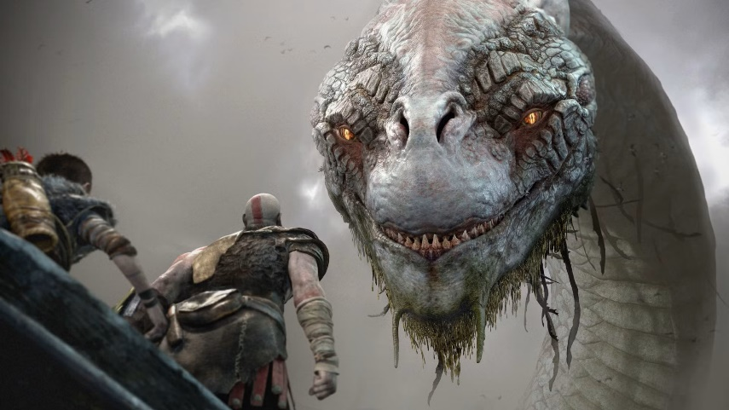
Levels, Key Locations, Progression and Travel
Next, each level or key location should be described in detail.
Some games have very large environments with many areas rather than single levels
  Describe the different areas in each environment, including their scale (e.g. 1km square, etc.)
In some games location is not relevant such as card and board games, but their description is still very important
Then, the different ways of traveling and progressing the game should be demonstrated:
  By reaching a target position
  By defeating all the enemies
  By achieving other conditions (describe them)

Slide 18
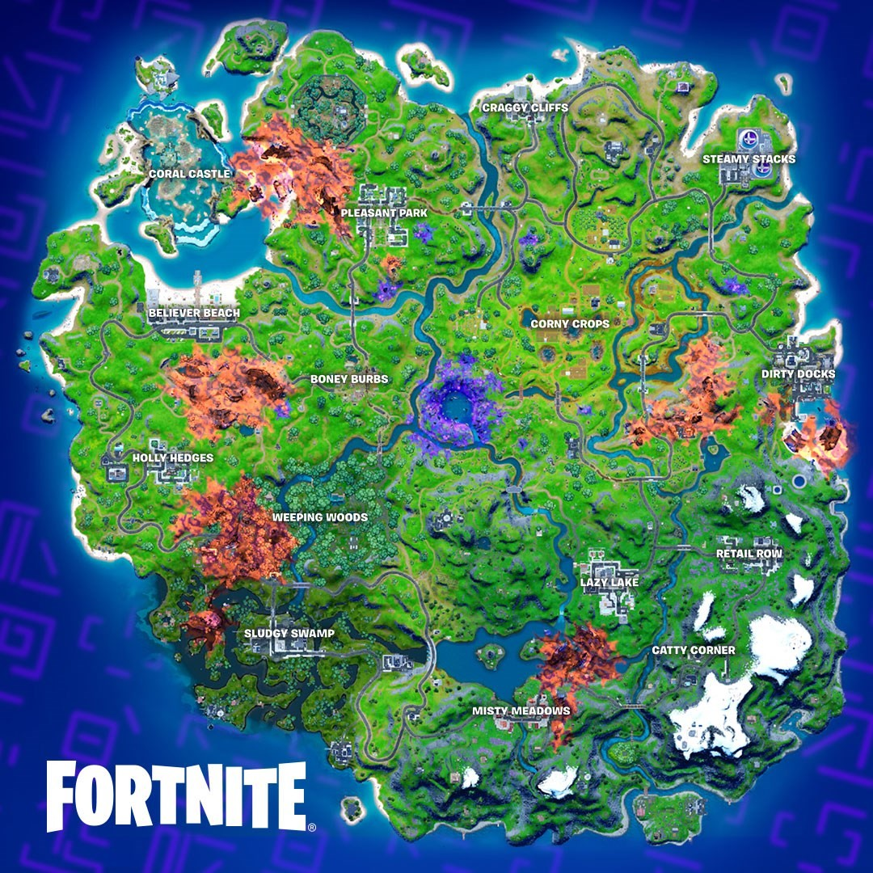
Example:
Locations, Progression and Travel: Fortnite
An island
Has varying topography
Has In-land water ways
Has several settlements
Can be explored freely on foot or using vehicles
A safe zone is selected randomly during a game session, and a storm consumes areas outside the safe zone
The safe zone reduces in size and the storm increases in size as the game progresses

Slide 19
Game Design Document Structure
Title Page
Game Overview
  Background
  Game play description
The Game World
  Levels / Key Locations
  Progression / Travel
Characters
  Player character(s)
  Non-player characters (NPCs)
  Character attributes
  Character abilities & development
Objects
  Interactive world elements (e.g. doors)
  Key Items (e.g. weapons)
  Pick-ups / Inventory Items
User Interface (UI)
  On screen display (OSD)
  Controller usage
  Camera / Point of View
Play Modes
Appendices (Detailed lists, tables etc.)

Slide 20
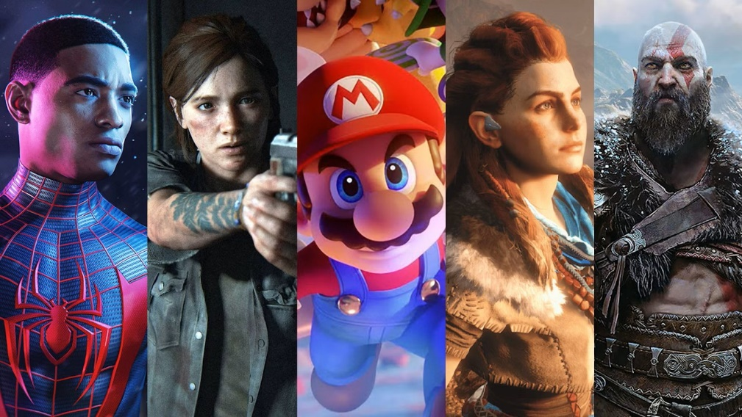

Characters
This chapter provides a detailed demonstration of the different game characters.
At first, the Player Character/s and their profile should be described in-depth.
Next, describe any other key characters that can NOT be controlled by the player (NPCs or AIs).
Some games do not have specific characters, but types of character instead (e.g. archers, battleships).
  Describe the player / non-player character types.

Slide 21
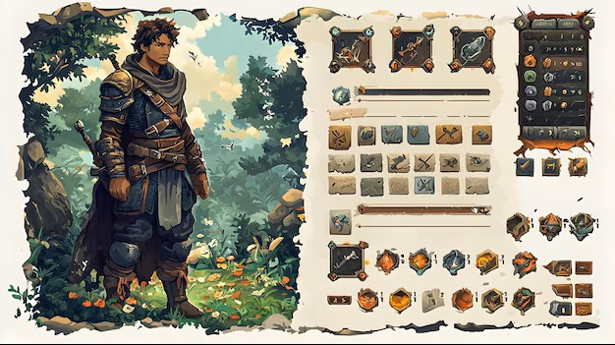
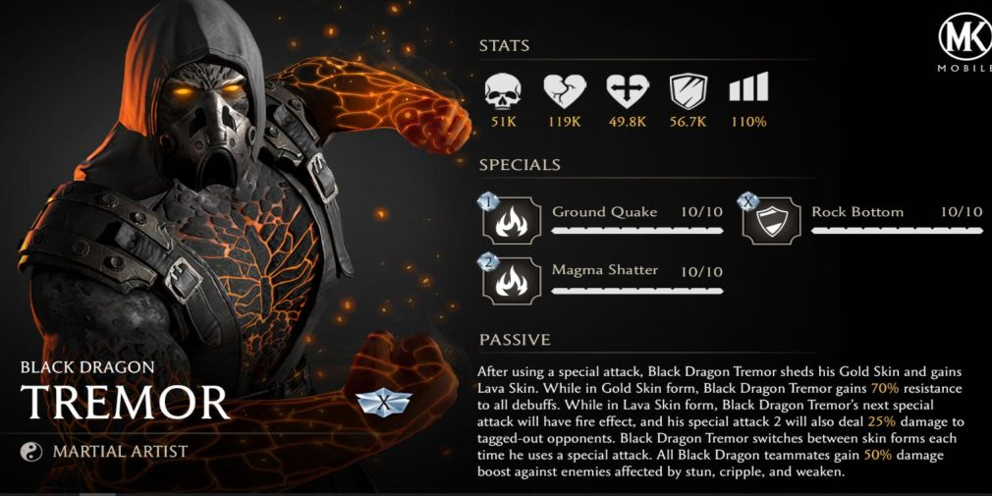
Character Attributes, Abilities and Development
Following the demonstration of each character profile, their attributes, abilities and development should be identified and demonstrated.
Character Attributes: are the basic stats that define a character’s capabilities (e.g., strength, health, speed, intelligence)
Character Abilities: are the Special skills or powers a character can use in gameplay (e.g., spells, attacks, stealth moves)
Character Development: is the progression and growth of a character over time, including levelling up, unlocking new abilities, or evolving story arcs

Slide 22
Game Design Document Structure
Title Page
Game Overview
  Background
  Game play description
The Game World
  Levels / Key Locations
  Progression / Travel
Characters
  Player character(s)
  Non-player characters (NPCs)
  Character attributes
  Character abilities & development
Objects
  Interactive world elements (e.g. doors)
  Key Items (e.g. weapons)
  Pick-ups / Inventory Items
User Interface (UI)
  On screen display (OSD)
  Controller usage
  Camera / Point of View
Play Modes
Appendices (Detailed lists, tables etc.)

Slide 23
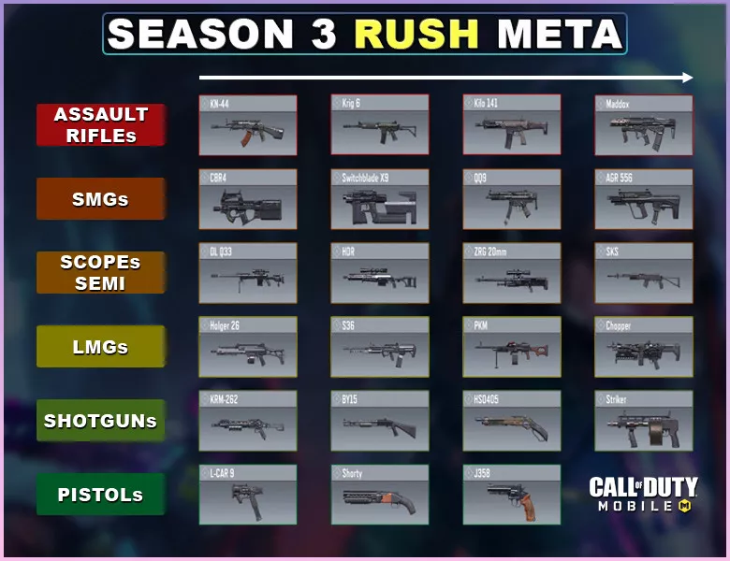
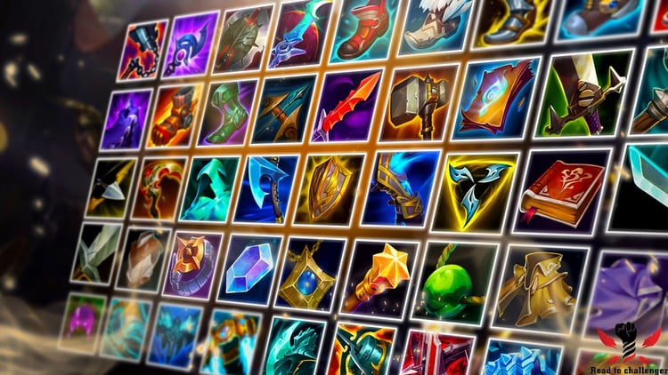
Objects and Object Attributes
Objects may range from keys to buildings - anything with a distinct game play function.
Categorise your objects into different types:
  Key Items: (e.g.) the weapons, main building types.
  Inventory Items / pick-ups: (e.g.) keys, food, power-ups, armour etc.
  Interactive environment elements: (e.g.) moving spikes, platforms, ramps etc.
Objects usually have attributes just as characters do. These need to be detailed along with the object description.
Some examples are:
  Strength, power requirement etc. for a building in an RTS.
  Range, Ammo type, clip size for weapons in an FPS
  Health gained for food / med-kit / potion
  Damage dealt by spikes / toxic waste

Slide 24
Game Design Document Structure
Title Page
Game Overview
  Background
  Game play description
The Game World
  Levels / Key Locations
  Progression / Travel
Characters
  Player character(s)
  Non-player characters (NPCs)
  Character attributes
  Character abilities & development
Objects
  Interactive world elements (e.g. doors)
  Key Items (e.g. weapons)
  Pick-ups / Inventory Items
User Interface (UI)
  On screen display (OSD)
  Camera / Point of View
  Controller usage
Play Modes
Appendices (Detailed lists, tables etc.)

Slide 25
UI Interface
The UI of a game has three components:
  The On Screen Display (OSD)
  The camera / viewpoint.
  The controller interface
In the GDD the selection of the most appropriate OSD, camera and viewpoints as well as the controller interface should be clearly justified.

Slide 26
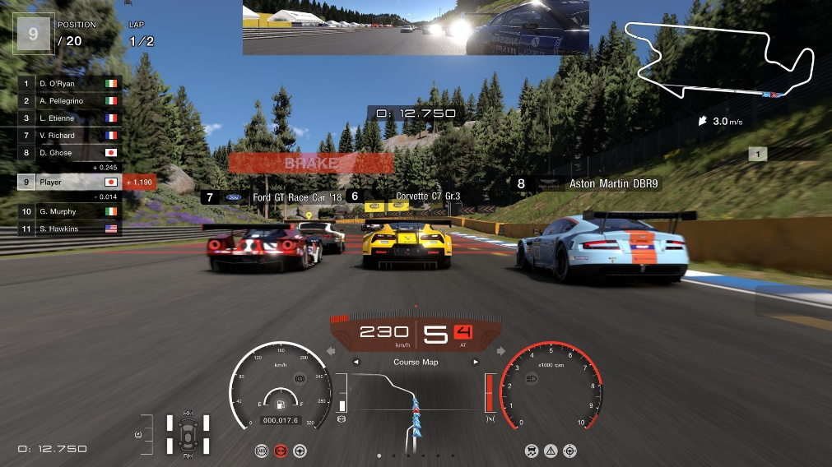
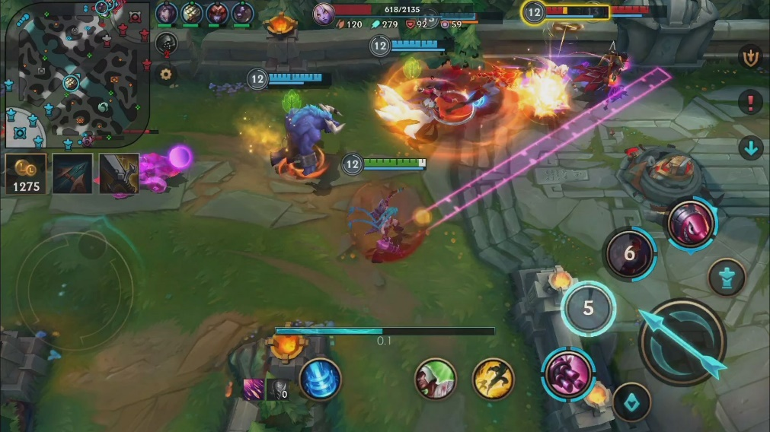
On Screen Display (OSD) in GDD
Refers to all the information and visual elements shown on the player’s screen during gameplay.
It helps players understand their status, objectives, and controls in real time
Purpose in GDD
  To define what the player sees during gameplay
  To ensure consistency and clarity in UI/UX design
  To guide programmers and artists in creating the interface
Typical Elements included:
  Health, Stamina, Energy (in the form of bars)
  Score, XP, currency
  Mini-maps, Inventory
  Objectives, missions and quests
  Ability cooldowns

Slide 27
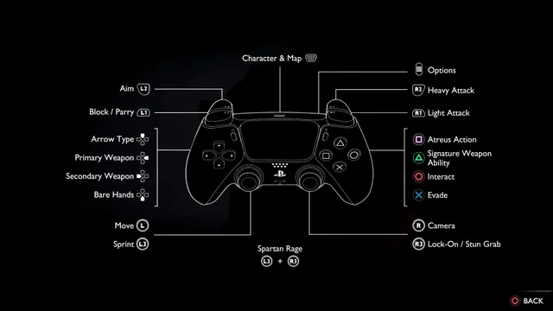
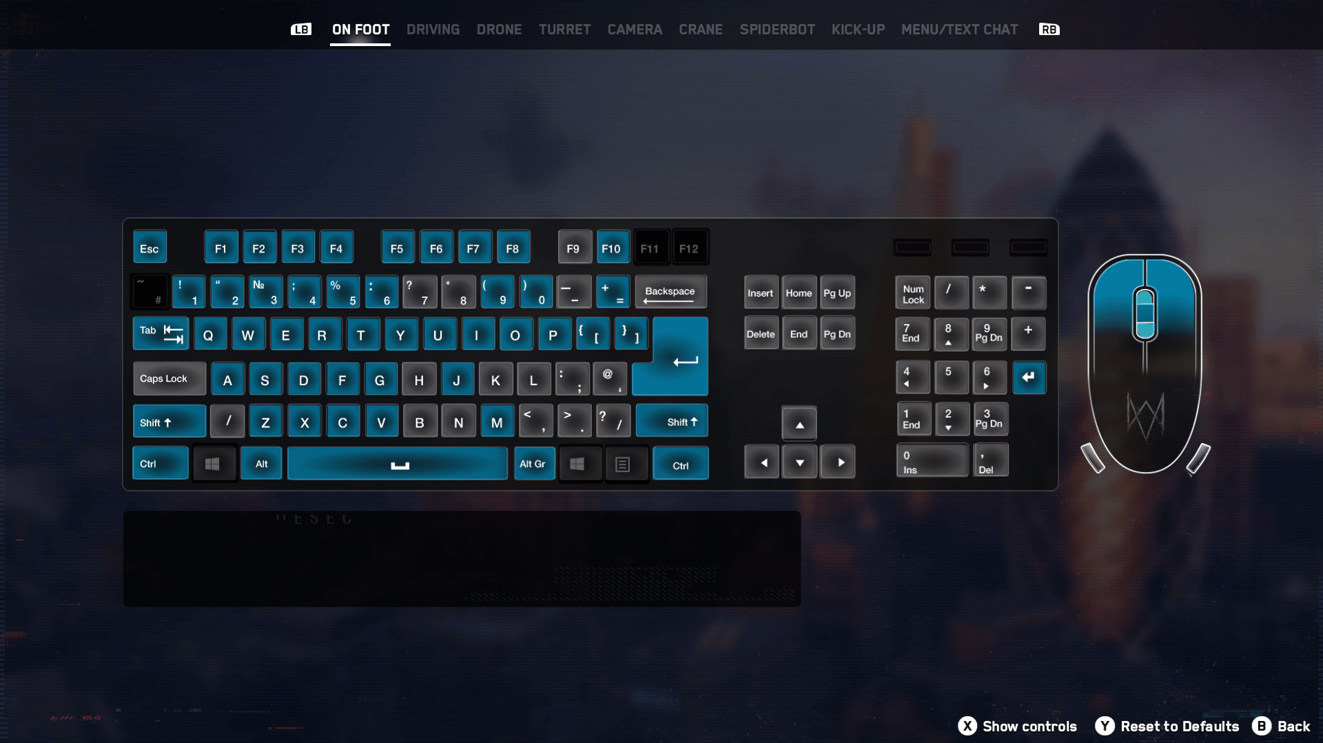
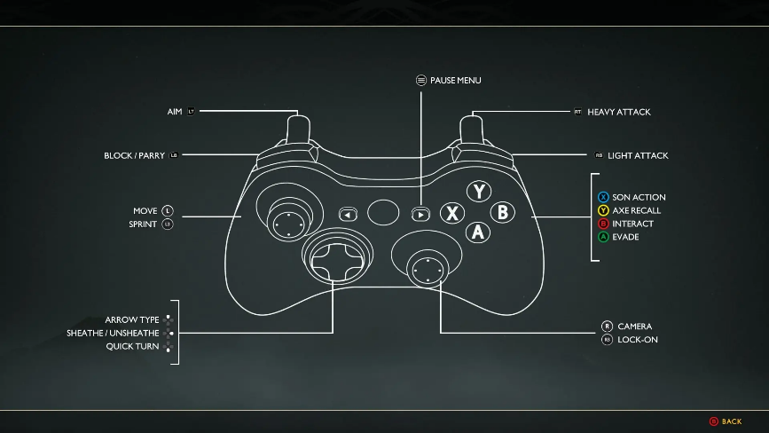
Controller Interface
Following OSD, the controller interface, depending on the target platform should be demonstrated.
The Controller Interface defines how the player interacts with the game through input devices such as controllers, keyboards, or touchscreens.
Purpose in GDD:
  To clearly communicate input schemes.
  Ensure consistency across different platforms

Slide 28
Game Design Document Structure
Title Page
Game Overview
  Background
  Game play description
The Game World
  Levels / Key Locations
  Progression / Travel
Characters
  Player character(s)
  Non-player characters (NPCs)
  Character attributes
  Character abilities & development
Objects
  Interactive world elements (e.g. doors)
  Key Items (e.g. weapons)
  Pick-ups / Inventory Items
User Interface (UI)
  On screen display (OSD)
  Controller usage
  Camera / Point of View
Play Modes
Appendices (Detailed lists, tables etc.)

Slide 29
Play Modes
This section details the various single and multiplayer game modes.
Also the variations for each mode, e.g.
  Single Player: Story mode, Timed Levels, Puzzle Mode, etc.
  Multiplayer: Deathmatch, Capture the flag etc.
  Differences between each variation should be clearly demonstrated.
Also this section should list:
  Initial settings that affect the game-play rules.
  Hours of game play for single player modes.
  State if there will be a way to save the game in progress.
  Also note if there will be any restrictions on game saving

Slide 30
Game Design Document Structure
Title Page
Game Overview
  Background
  Game play description
The Game World
  Levels / Key Locations
  Progression / Travel
Characters
  Player character(s)
  Non-player characters (NPCs)
  Character attributes
  Character abilities & development
Objects
  Interactive world elements (e.g. doors)
  Key Items (e.g. weapons)
  Pick-ups / Inventory Items
User Interface (UI)
  On screen display (OSD)
  Controller usage
  Camera / Point of View
Play Modes
Appendices (Detailed lists, tables etc.)

Slide 31
Appendices
Use the appendices to remove detail from the main document. Here are some examples:
  A list of 30 spells – RPG games
  A list of 25 cars with engine – racing games
  A list of character moves and combinations (e.g. high punch, low block) – Fighting game
Other documents:
  Graphics / Animation lists
  Sound Effect / Vocal lists
  Music requirements and style
  Future directions (ideas for the sequel)
  Historical Notes (e.g. for a war game)
  References (if you use any external content)

Slide 32
Summary
There are four main types of documents used and developed in different phases of the Games Development life cycle:
  High Concept Document: A brief summary that presents the core idea and hook of a game
  Concept Document: An expanded outline detailing how the game works and what makes it unique
  Pitch Document: A presentation designed to sell the game idea to investors or publishers
  Game Design Document: The comprehensive blueprint that guides developers on how to build the game
Game Design Document chapters: 1) Game Overview, 2) Game World, 3) Characters,
4) Objects, 5) User Interfaces, 6) Play Modes, and 7) Appendices

Slide 33
Questions?!

